Slide 1
MediX Workshop
Valerie Simonis w/ slides from Dr. Raicu
5/1/2015

Slide 2
Before we start… Introductions
Who am I?
Valerie Simonis
BS In Math/CS from DePaul
working towards a PhD in CS
CV, AI, DM
Scripting: SAS, R, SPSS, Matlab
Programming: Java, Python
Who are you?
Name
Degree & Major/Concentration
Programming/scripting experience

Slide 3
Agenda
Goal: Process C. elegans images in MATLAB and analyze patterns in features
MATLAB basics
Image Processing : Introduction and MATLAB tutorial
Image Features: Introduction and MATLAB tutorial
Image Analysis: Decision Trees and MATLAB tutorial

Slide 4
MATLAB basics
When to use MATLAB
Prototyping
Easy to use
Many functions already implemented (especially for Image Processing)
Objected-oriented approach is not appropriate
Matrix operations
Avoid using for loops!
Can inspect elements easily
How to use MATLAB
Development environment
Basic programming

Slide 5
Finding patterns in images

Slide 6
Overview of the field
Image Processing (CSC 381/481):
Produces images that are enhanced, segmented, or processed in any way to increase the quality of an image and its understanding and interpretation
Image Analysis (CSC 382/482):
Produces numerical descriptors, patterns from images
Uses Machine Learning ( ), and Data Mining (CSC 367/ )
Computer Vision (CSC … ):
Often produces 3D models from image data; the image data can take many forms, such as video sequences, views from multiple cameras, or multi-dimensional data from a medical scanner.

Slide 7
Introduction to Image Processing
Image Types, Image enhancement and segmentation

Slide 8
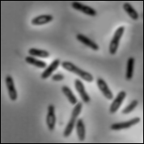
Intensity image or monochrome image:
each pixel corresponds to light intensity
normally represented in gray scale (gray
level).
Gray scale values

Slide 9
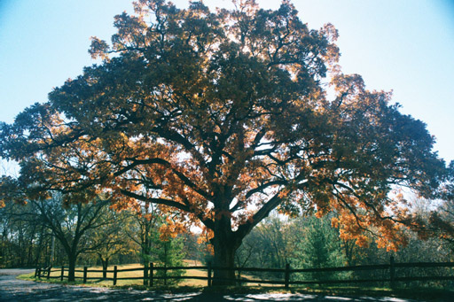
Color image or RGB image:
each pixel contains a vector
representing red, green and
blue components.
RGB components

Slide 10

Binary image or black and white image
Each pixel contains one bit :
1 represent white
0 represents black
Binary data

Slide 11
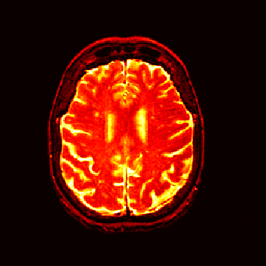
Index image
Each pixel contains index number
pointing to a color in a color table
Color Table
Index No. | Red component | Green component | Blue component
1 | 0.1 | 0.5 | 0.3
2 | 1.0 | 0.0 | 0.0
3 | 0.0 | 1.0 | 0.0
4 | 0.5 | 0.5 | 0.5
5 | 0.2 | 0.8 | 0.9
… | … | … | …
Index value

Slide 12
Image Processing Sequence
Original Image
Image Enhancement
Thresholding
Morphological Operations
Segmented
Image
Histogram equalization
Contrast Stretching
Mean pixel value
Otsu
Histogram
Area Under Histogram
Opening
Closing
Connected Components

Slide 13
Segmentation: threshholding
Simple theshholding
Otsu

Slide 14
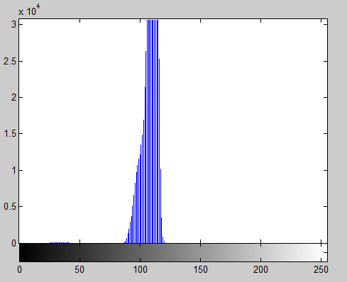
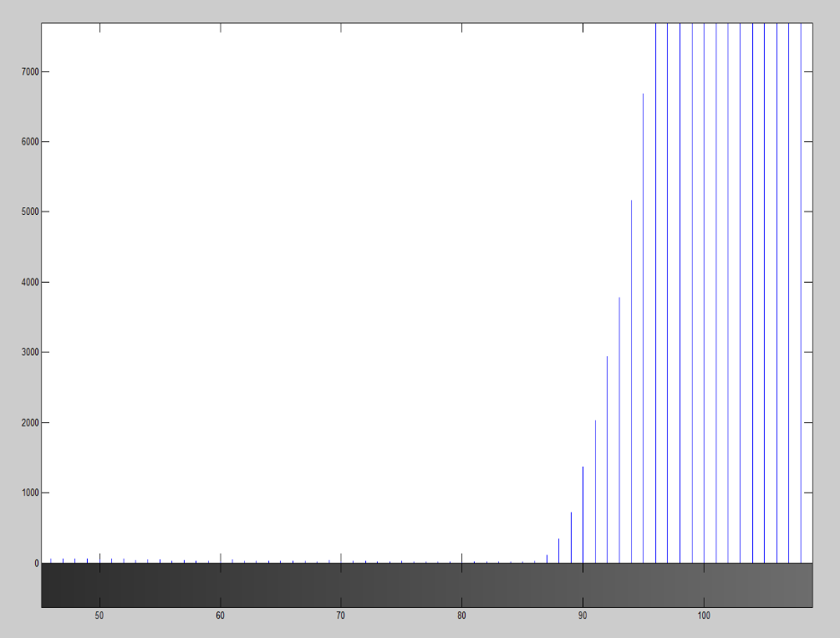
Threshold Descriptions
Find max = I(x,y) such that histogram is maximal
Find T = I(x,y) such that T is the nearest minimum to the left of max
Find T = I(x,y) such that the number of pixels in area to the left of T approximates the average area of a worm (4223)
“Histogram”
“Area Under Histogram”
max
worm
background
worm
background
# of pixels
==
avg area of worm
Nearest min to the left
T = 86
T = 78

